Slide 1
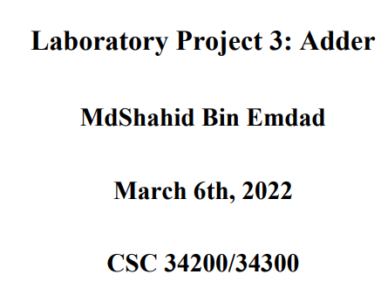
Notes:
The objective of this assignment is to design and understand the specifications of adders and create waveforms for them.

Slide 2
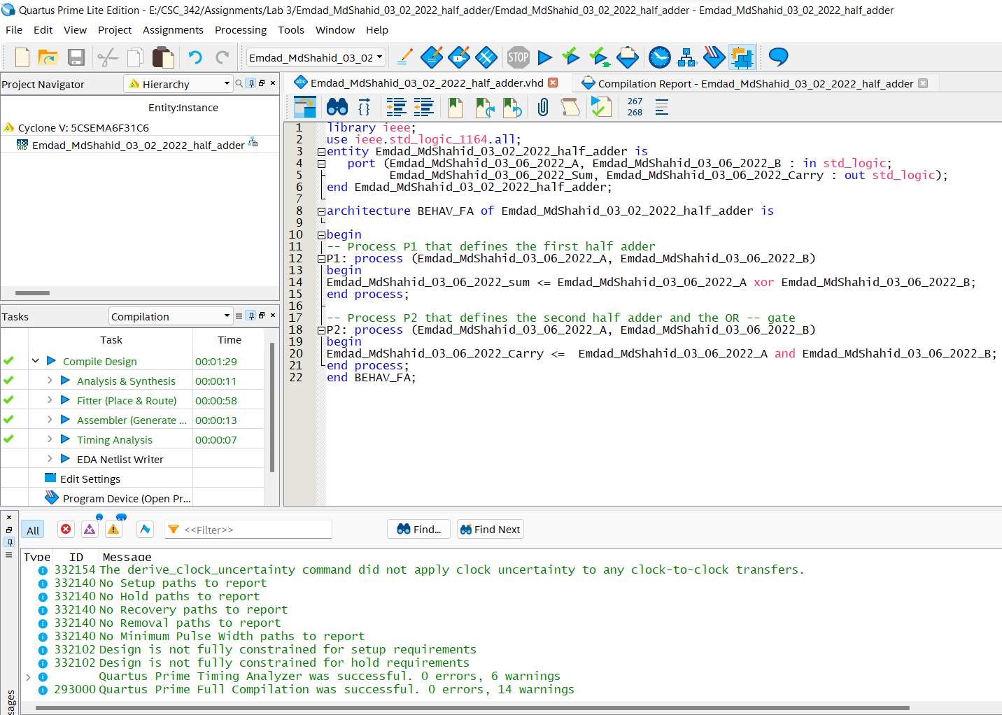
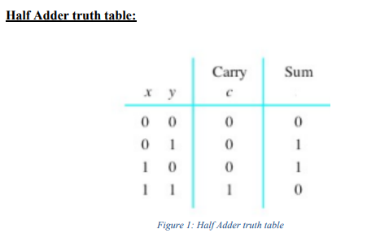
Notes:
I used two inputs one for the first operand of the adder and other one is the second operand of the adder. I also used carry which is the bit that is carried in from the next less significant stage.

Slide 3
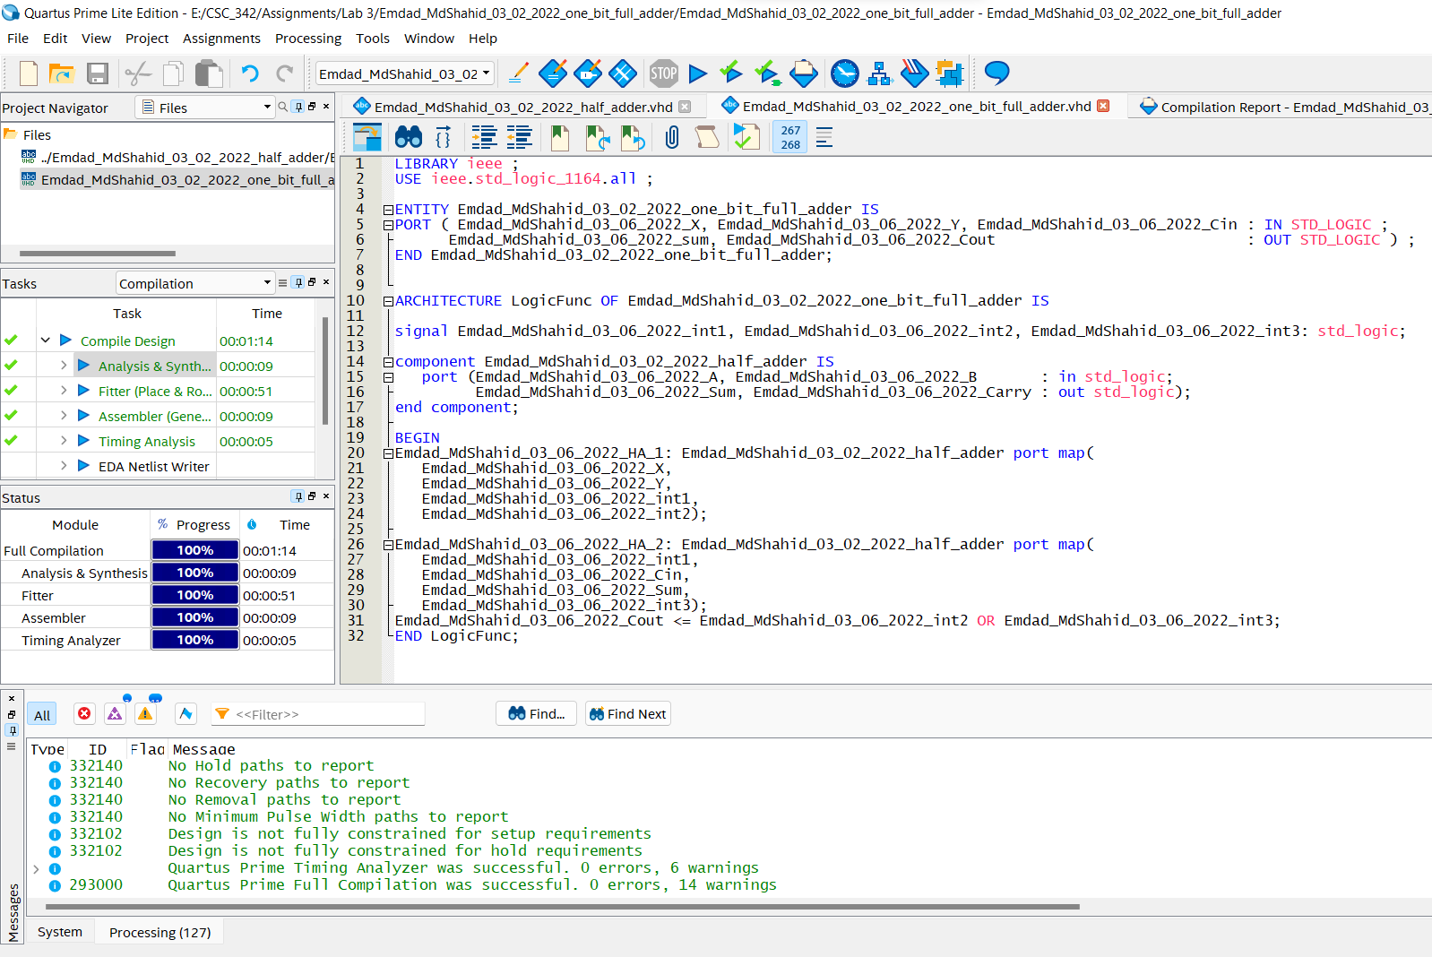
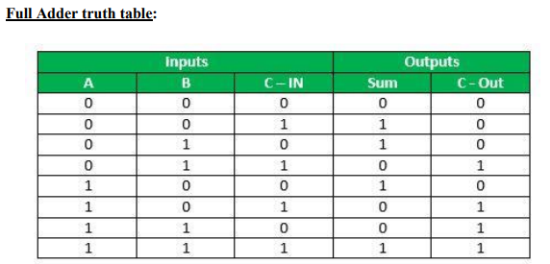
Notes:
I used two inputs one for the first operand of the adder and other one is the second operand of the adder. I also used cin which is the bit that is carried in from the next less significant stage. I used cout for the output which is bit that is carried over from an addition when necessary and sum is the last bit of the result.

Slide 4
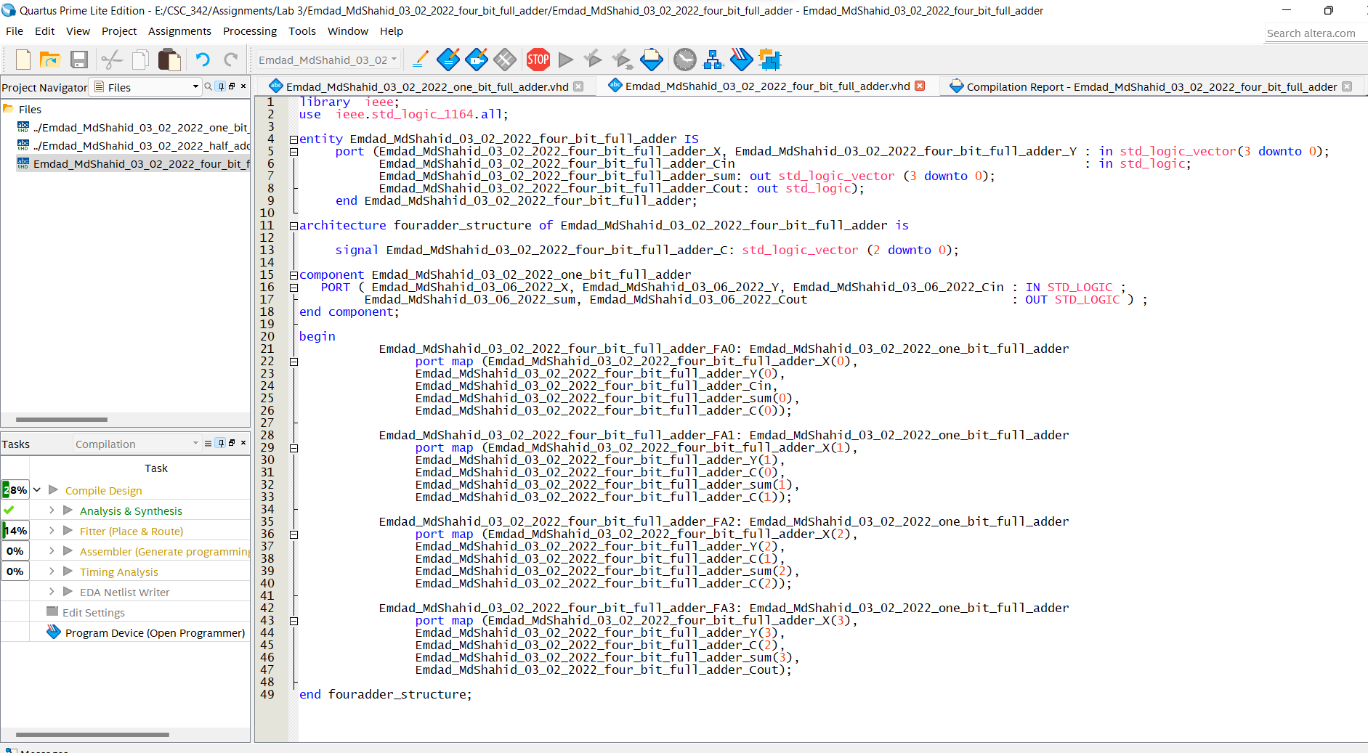
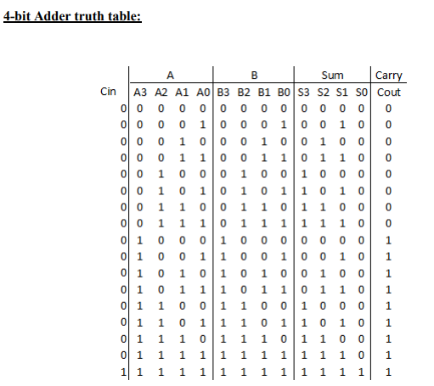
Notes:
I used two inputs one for the first operand of the adder and other one is the second operand of the adder. I also used cin which is the bit that is carried in from the next less significant stage. I used cout for the output which is bit that is carried over from an addition when necessary and sum is the last bit of the result.

Slide 5
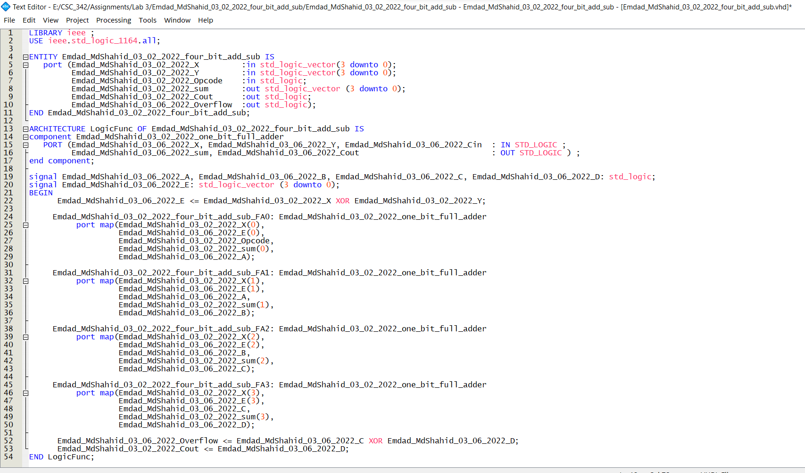
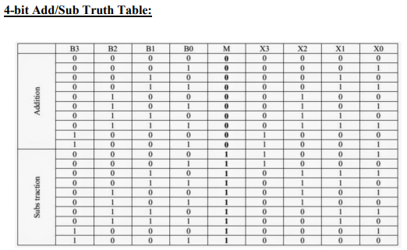

Slide 6
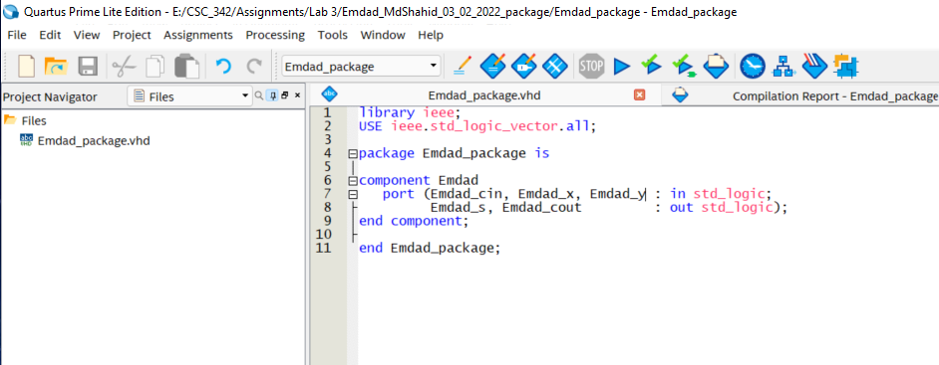
Notes:
I added my components in a package and compiled it and created a package for future use.

Slide 7
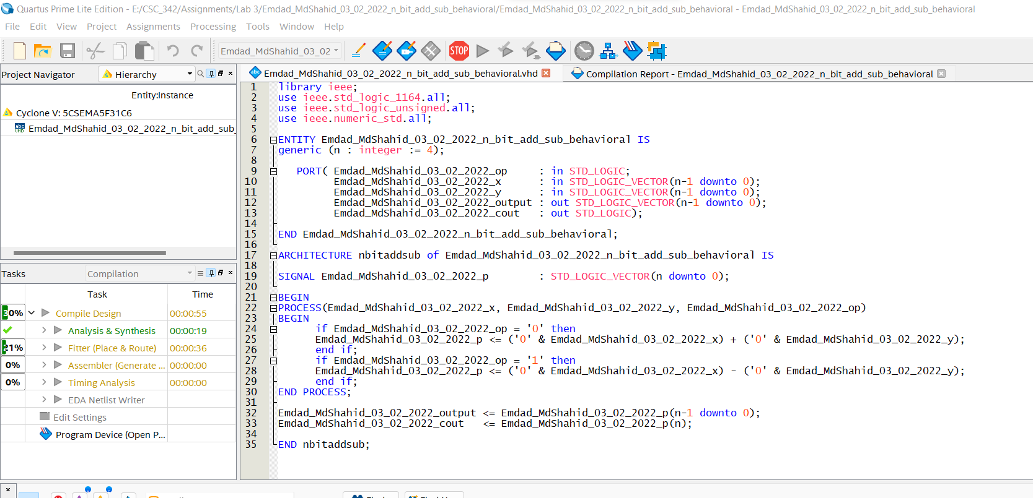
Notes:
n-bit add/sub using behavioral VHDL code

Slide 8
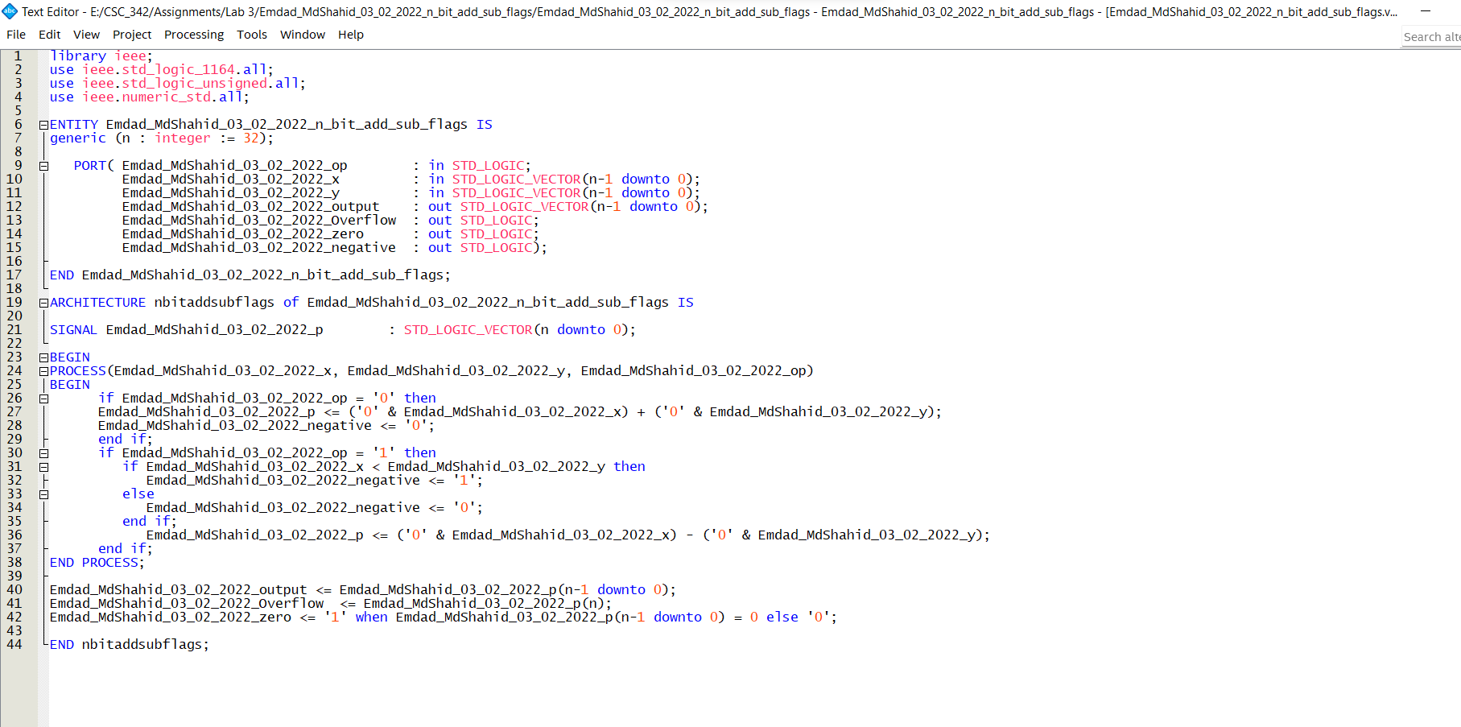

Slide 9
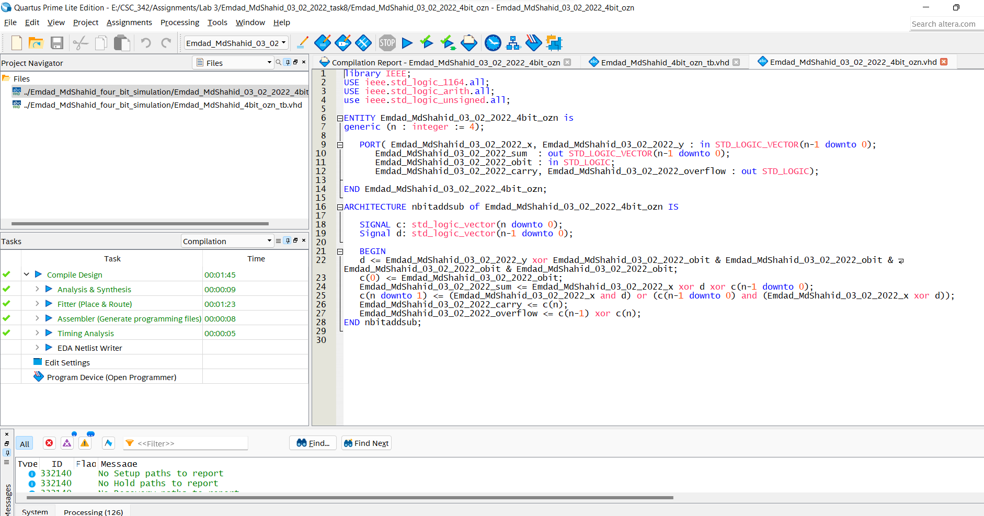
Notes:
Task 8 was divided into 2 parts. First, we worked on the 4-bit design in Modelsim and to verify that I created a testbench to get a waveform out which was provided in the simulation section.

Slide 10
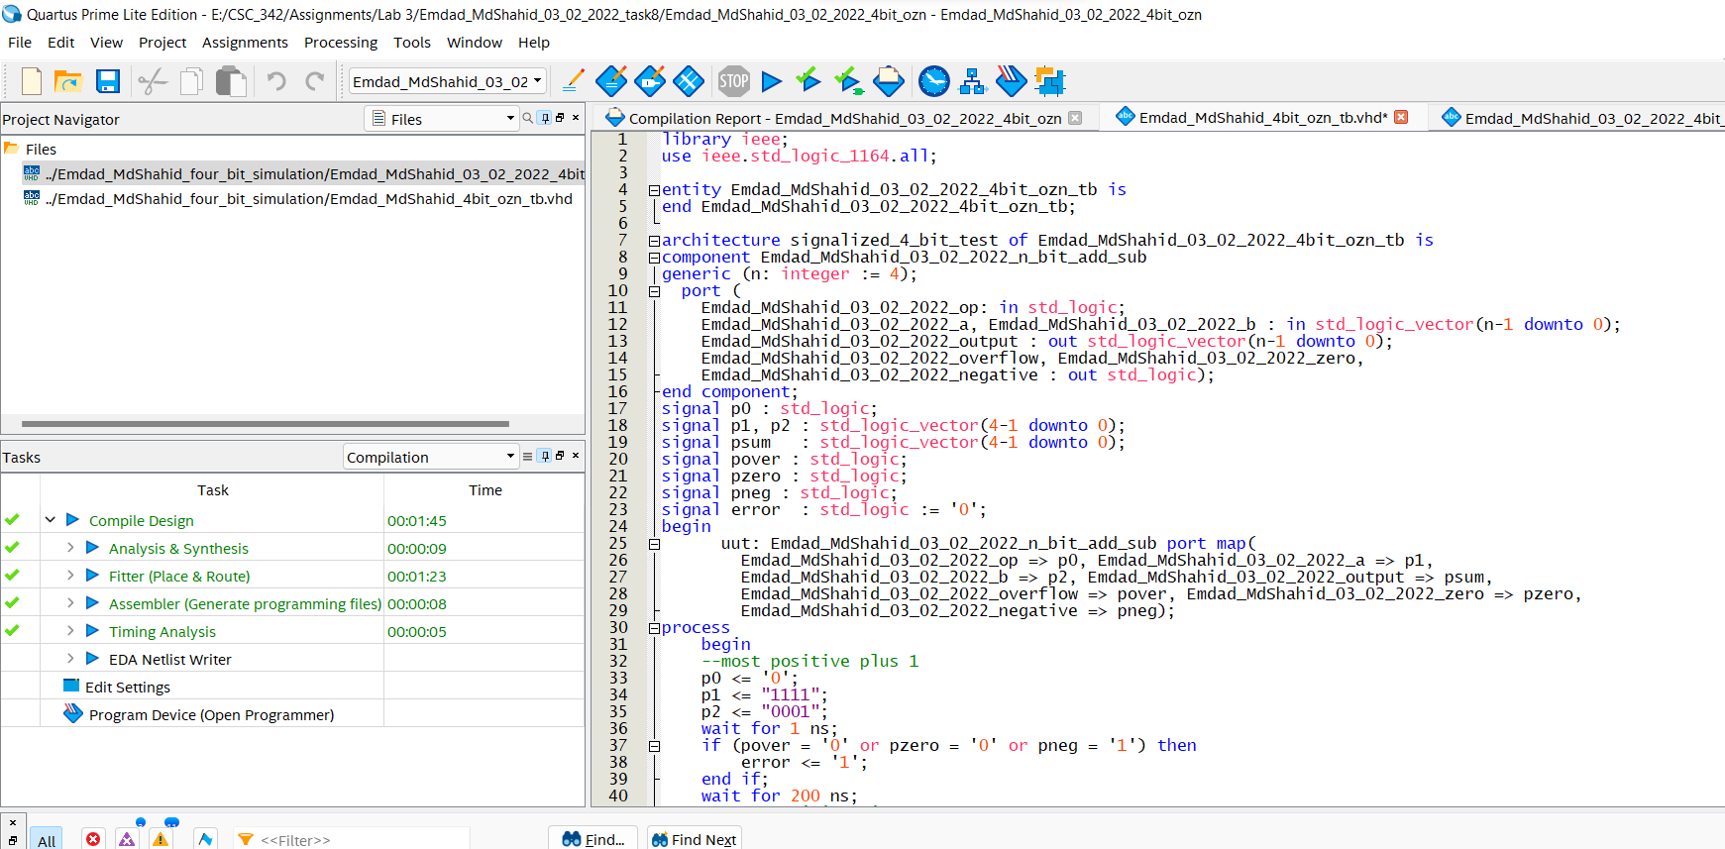

Slide 11
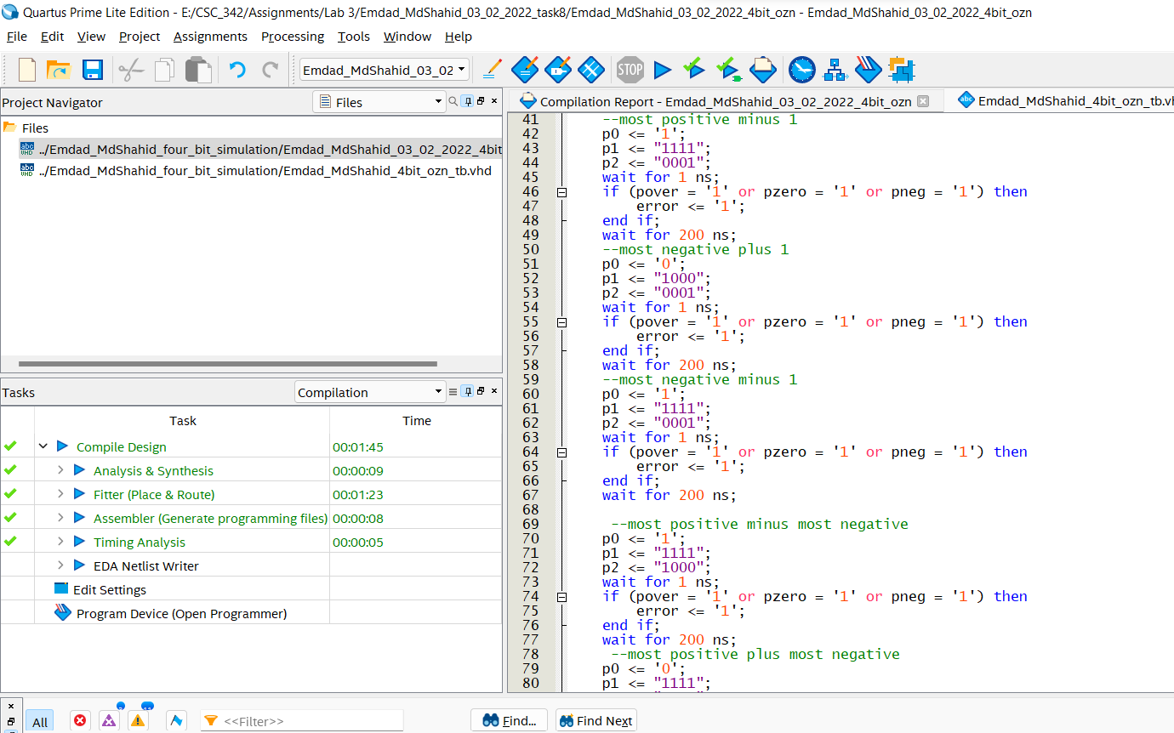

Slide 12
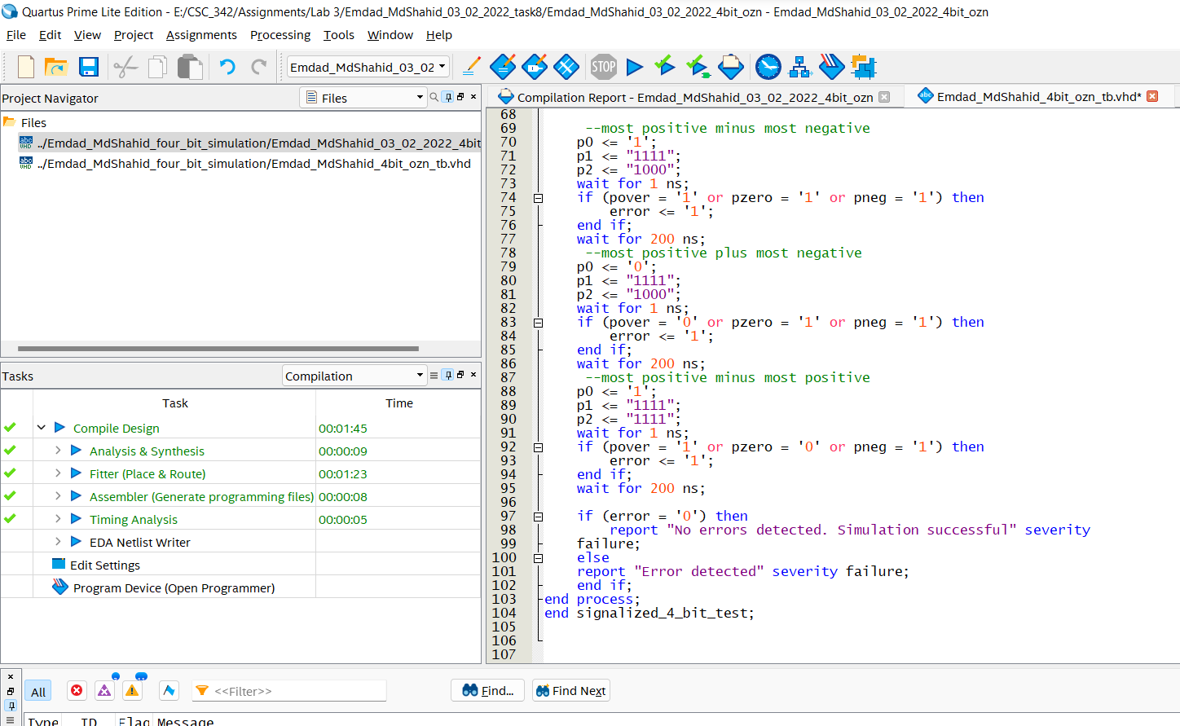

Slide 13
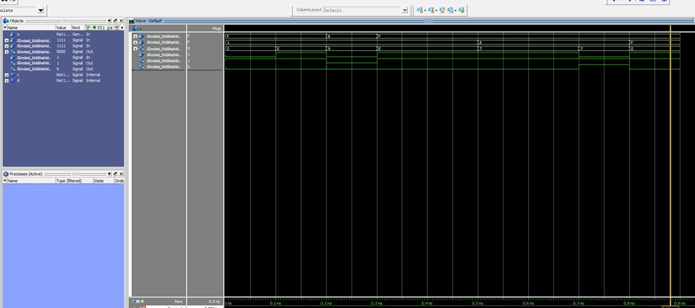
Notes:
4-bit simulation in Modelsim

Slide 14
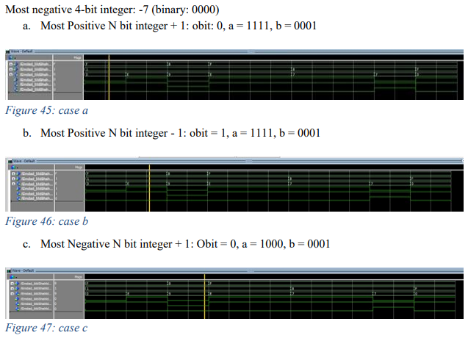

Slide 15
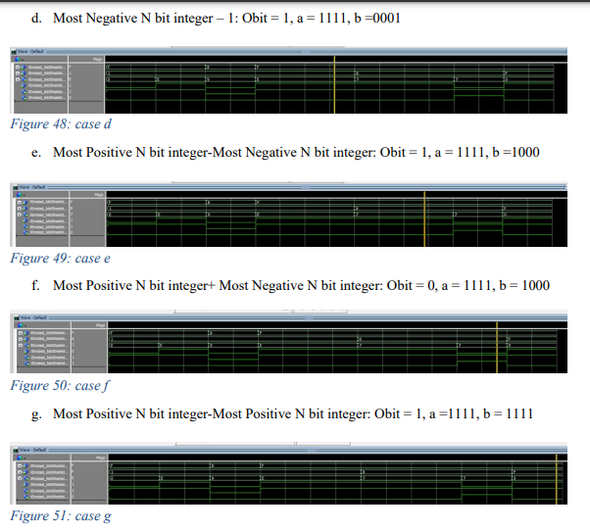

Slide 16
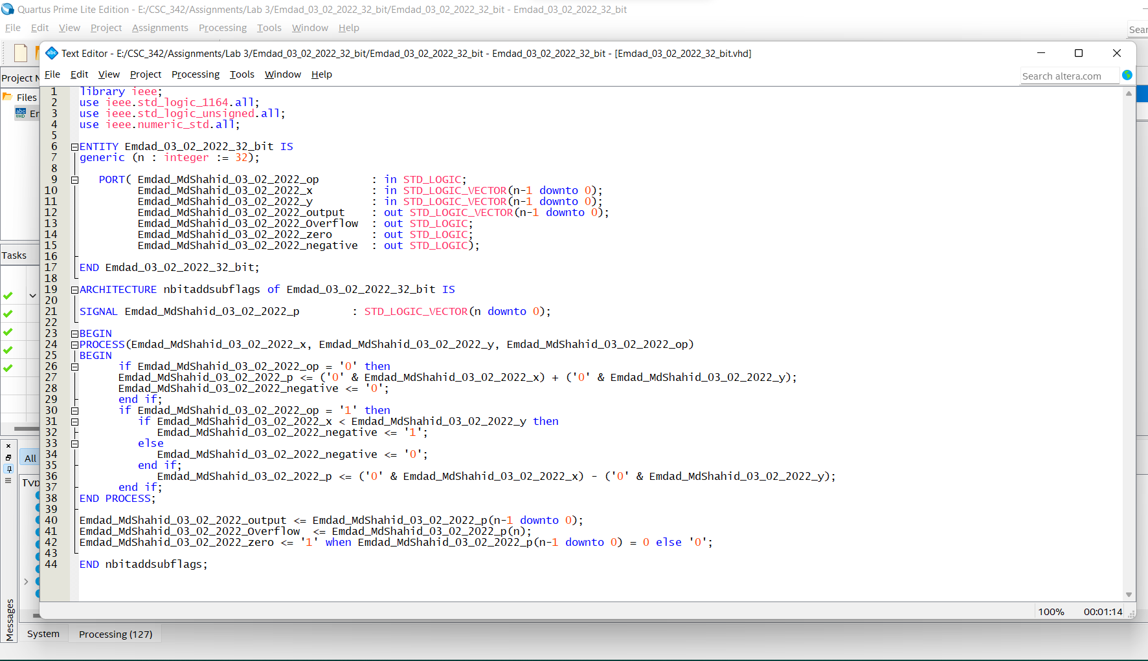
Notes:
To make a 32-bit adder, the necessity is 4 8-bits full adders. It will result in a 32bit sum and create carry outputs

Slide 17
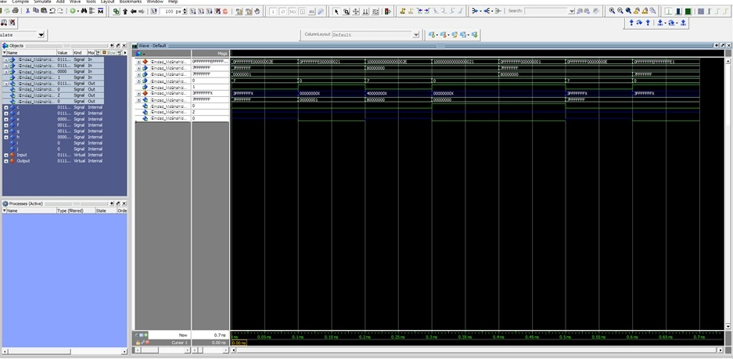

Slide 18
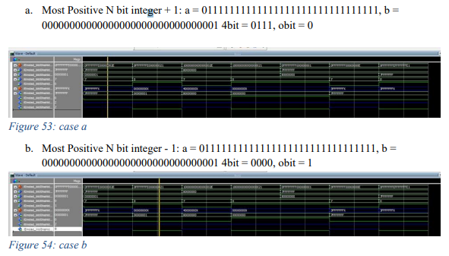
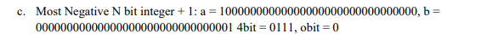
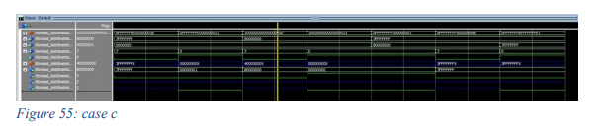

Slide 19
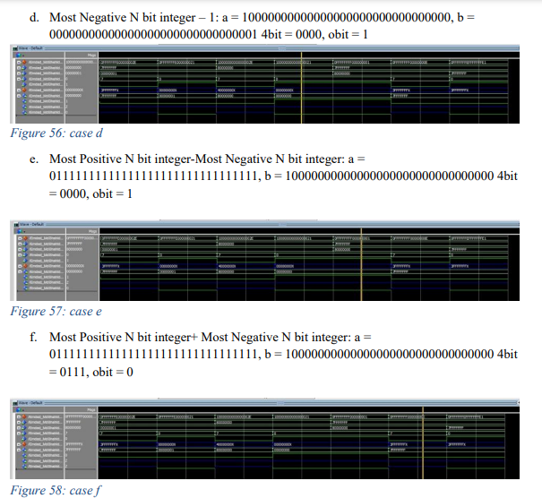

Slide 20
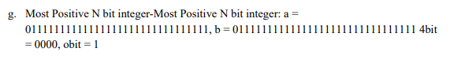
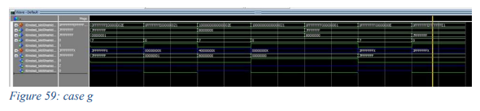

Slide 21
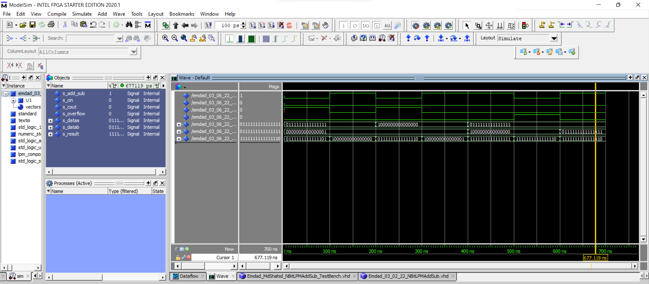
Notes:
N-bitlmp add/sub

Slide 22
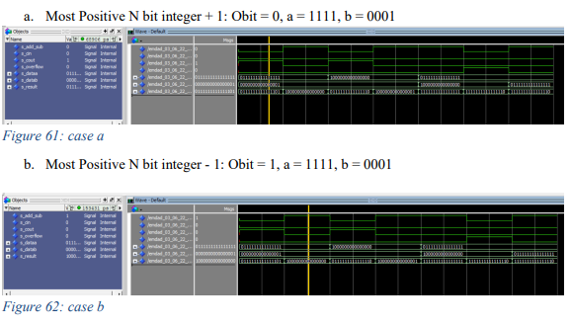
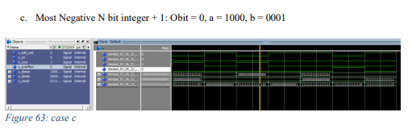

Slide 23
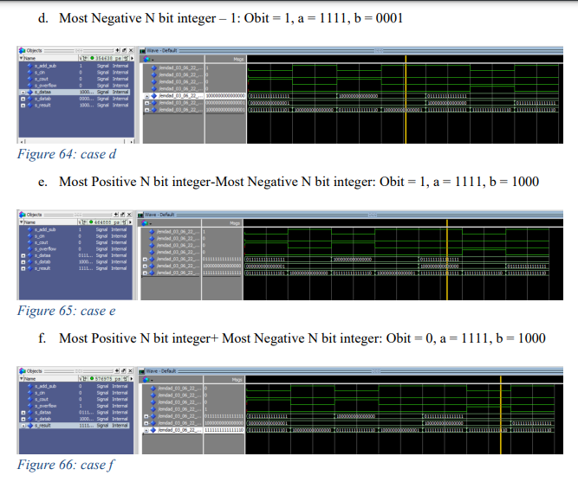

Slide 24
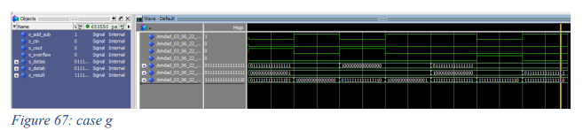

Slide 25
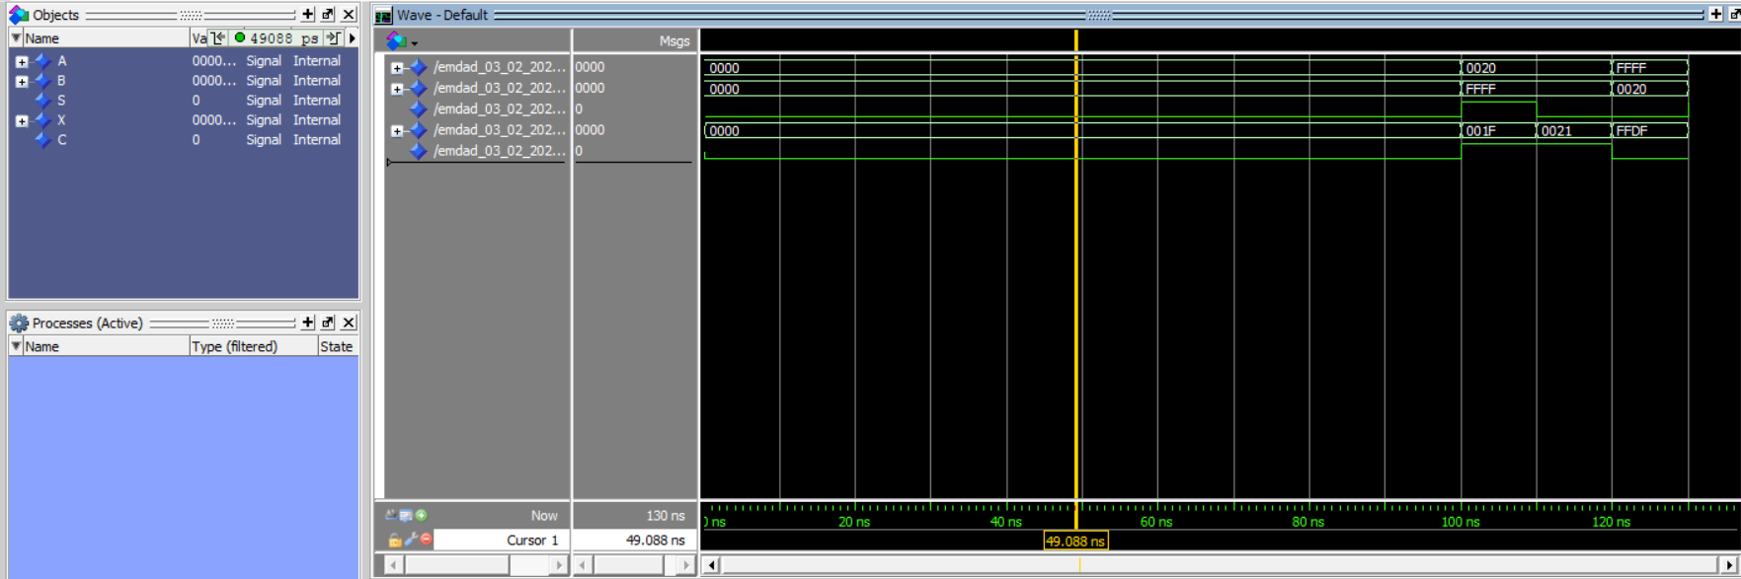
Figure 68: 16bit simulation by testbench without error
Notes:
I used 2 cins, (cin1 and cin2) which are the first and second operand of the adder for the 16 bits. I also had op which is the bit that carried in from the less significant stage. For the outputs, I had neg which is the carry output that carried in from addition, sum (sum of the two inputs, cin1 and cin2), overflow which checks for overflow errors and finally zero for two input addition.

Slide 26
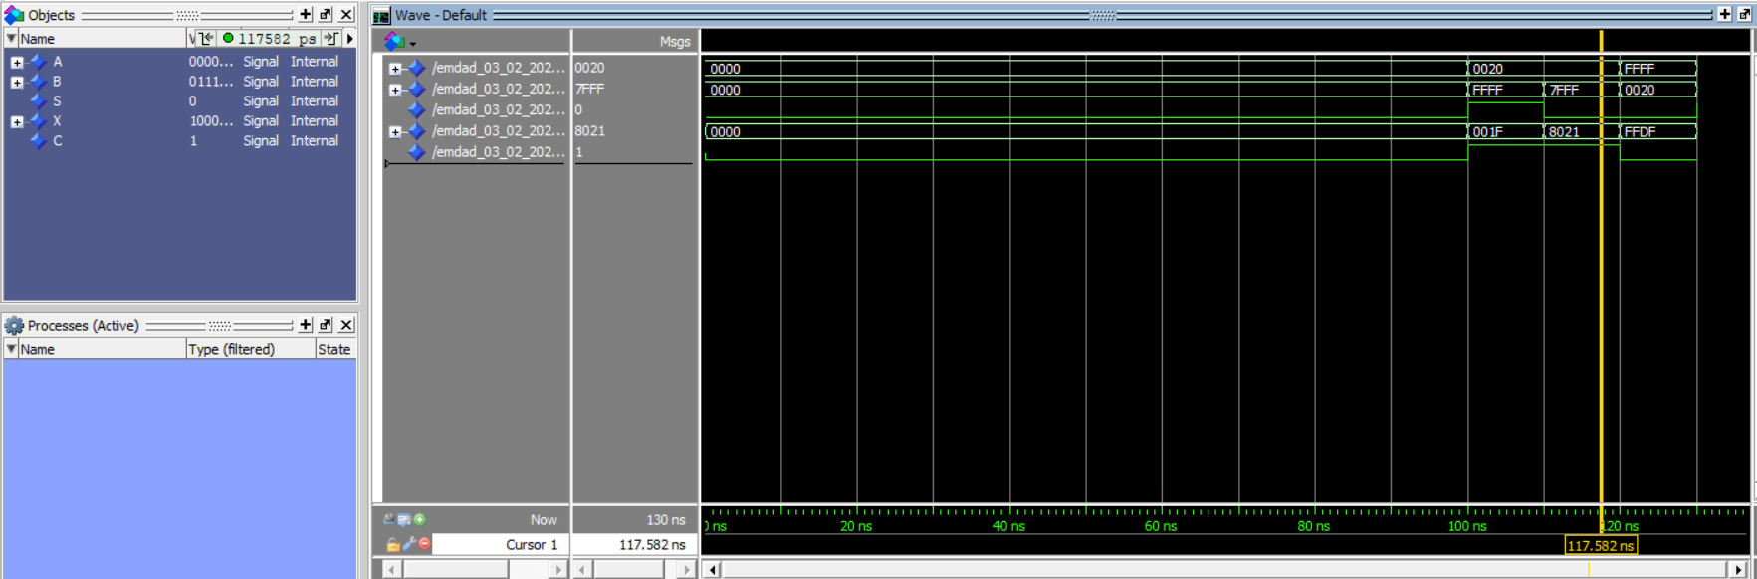
Figure 69: 16bit simulation with error
In figure 69, the hexadecimal values are different here. Therefore, it shows the error in the simulation.

